Slide 1
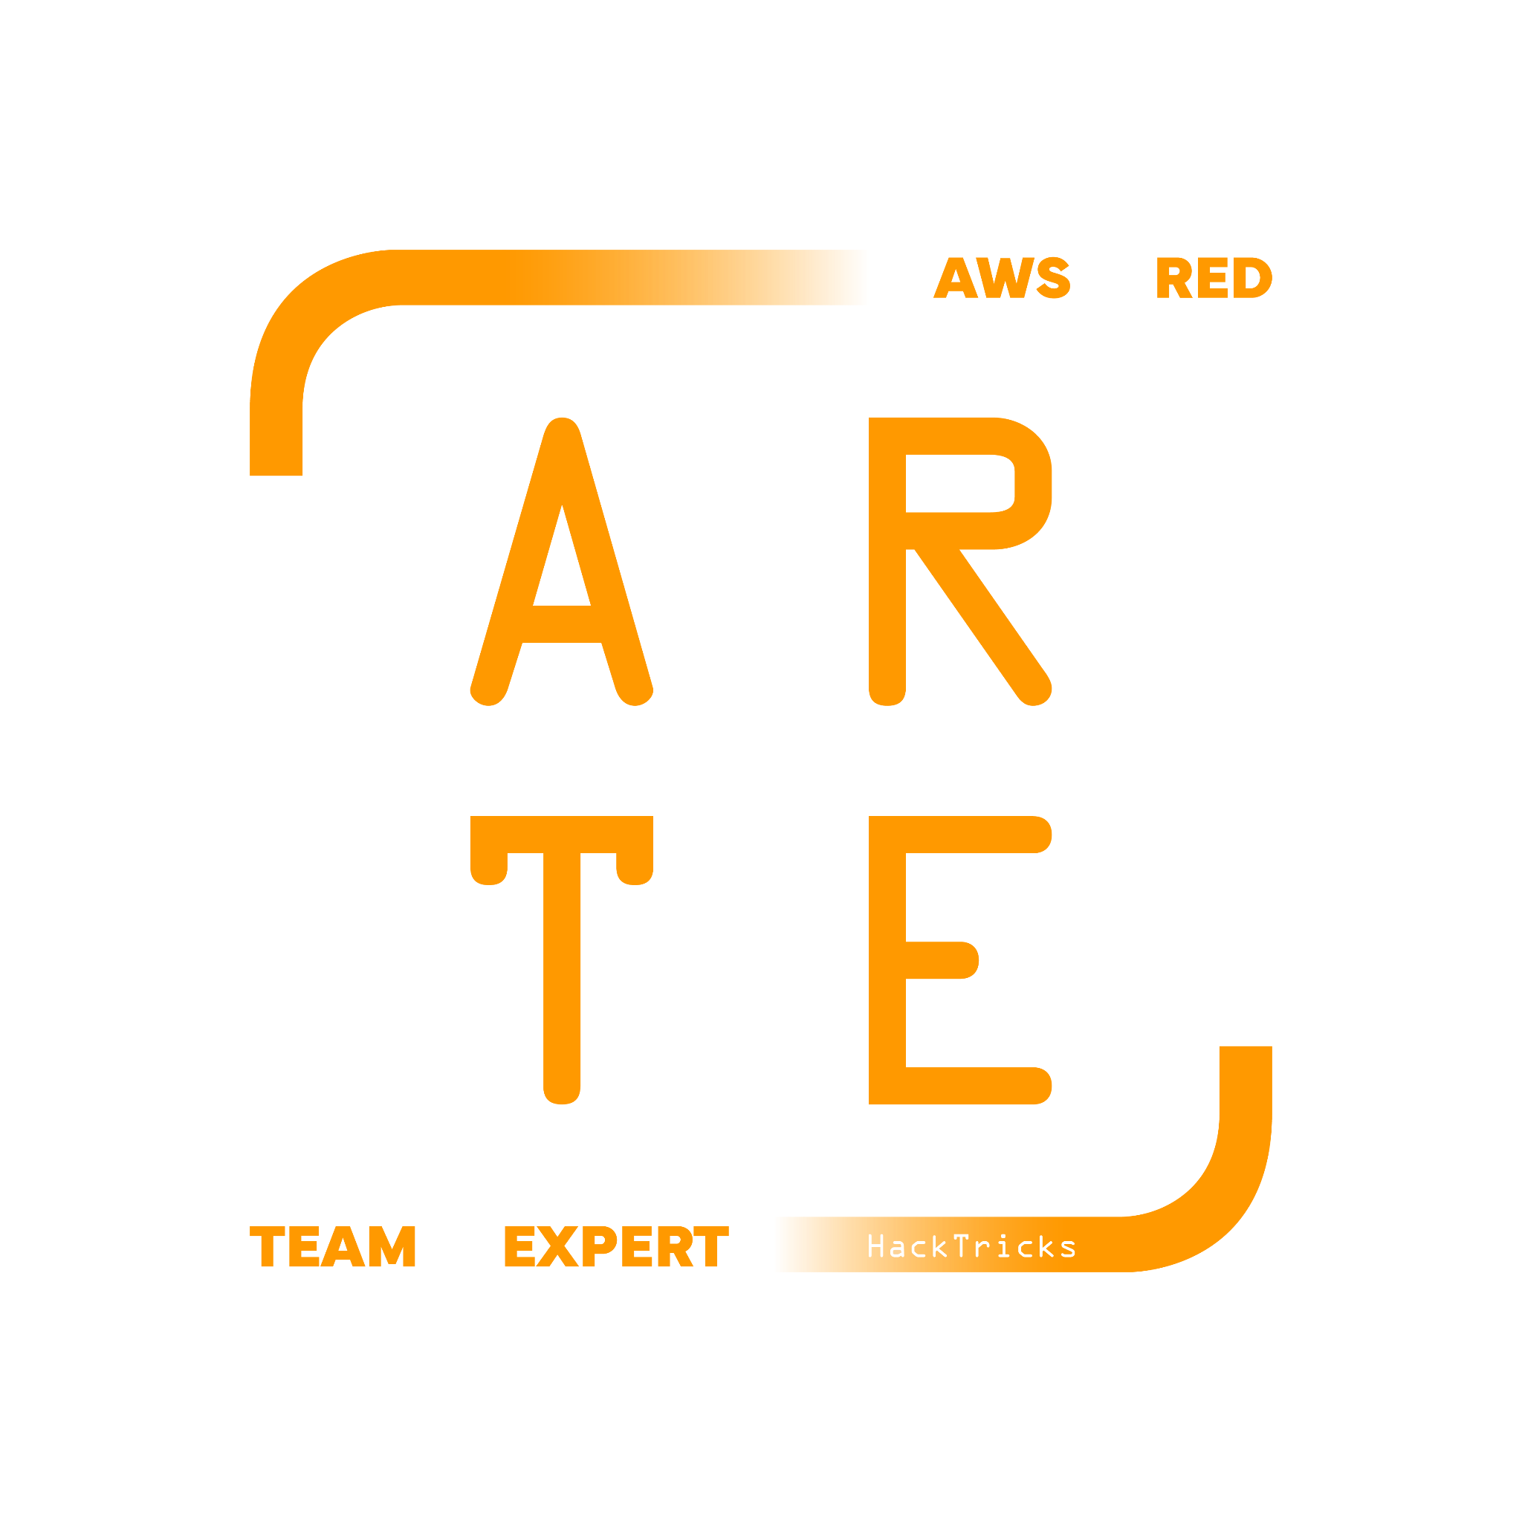
AWS Organization
HackTricks Training
https://t.me/CyberFreeCourses

Slide 2
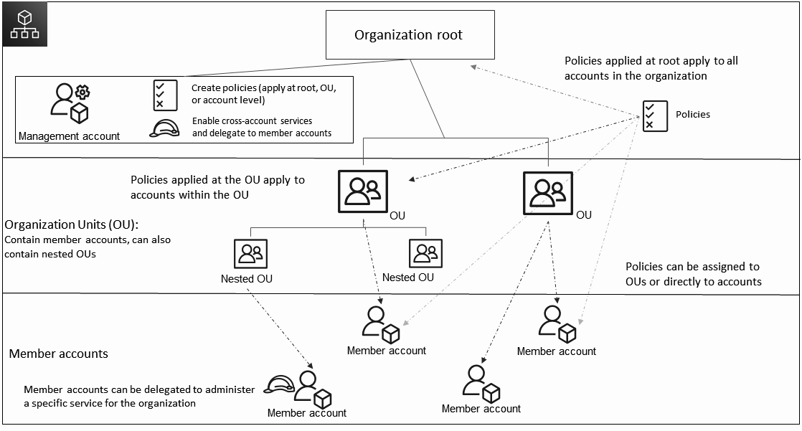
AWS Organization Structure
https://t.me/CyberFreeCourses
Image from https://docs.aws.amazon.com/organizations/latest/userguide/orgs_getting-started_concepts.html

Slide 3
AWS Organization Structure
In summary:
Management account (root account).
Can contain OUs and Accounts
Org wide / OU wide / Account Policies are defined here
Can use AWS services (not recommended)
Organization Units:
Can contain OUs and Accounts
Accounts
Can use AWS services
https://t.me/CyberFreeCourses
From https://cloud.hacktricks.xyz/pentesting-cloud/aws-pentesting/aws-basic-information#accounts

Slide 4
Management Account (root)
Create & organize OUs
Create & invite accounts
Accounts can only be in 1 Org
Delete OUs, Accounts & the entire Org
Remove Accounts (billing in the account must be set)
Apply policies at any level
Billing of all the accounts
It’s NOT THE SAME as the root user of each account
https://t.me/CyberFreeCourses
From https://cloud.hacktricks.xyz/pentesting-cloud/aws-pentesting/aws-basic-information#accounts

Slide 5
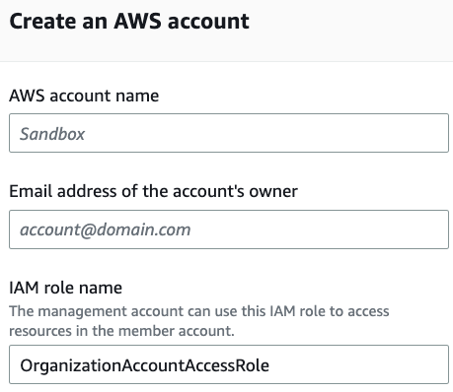
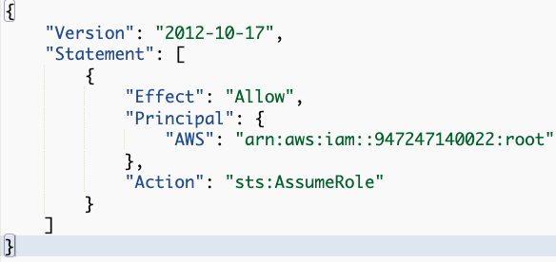
Management Account (root)
By default, “anyone” from management can access any child account
Role OrganizationAccountAccessRole is created trusting root account.
The user from the management account needs to have permissions to assume the role also in the management account
https://t.me/CyberFreeCourses
From https://cloud.hacktricks.xyz/pentesting-cloud/aws-pentesting#compromising-the-organization

Slide 6
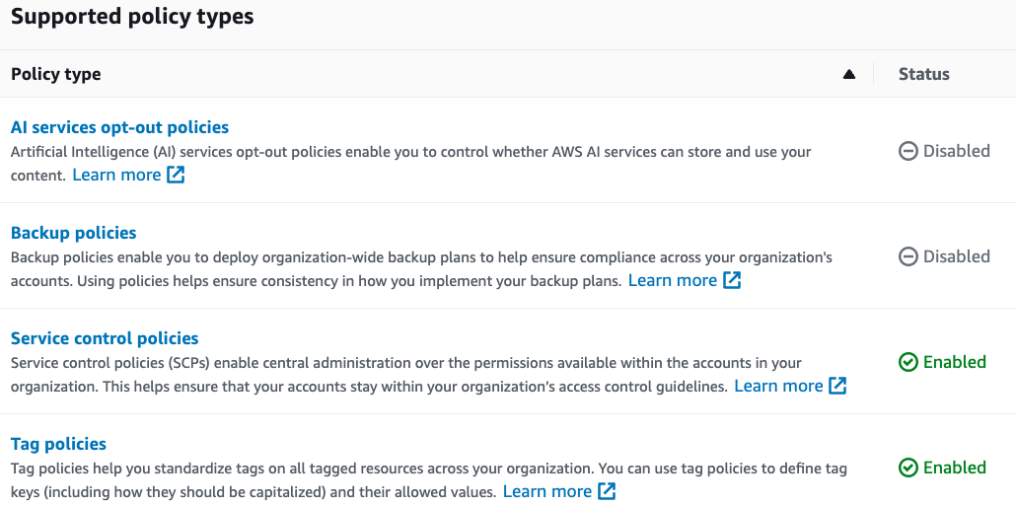
Organization Policies
https://t.me/CyberFreeCourses

Slide 7
Service Control Policies
Specifies the services and actions that users and roles can use in the accounts that the SCP affects
They don’t grant permissions, only limits them
Even children accounts root users will be affected by SCPs
Only restricts principals in the account, so other accounts are not affected. This means having an SCP deny s3:GetObject will not stop people from accessing a public S3 bucket in your account.
Examples:
Deny the root account entirely
Only allow specific regions
Only allow white-listed services
Deny GuardDuty, CloudTrail, and S3 Public Block Access from being disabled
Deny security/incident response roles from being deleted or modified.
Deny backups from being deleted.
Deny creating IAM users and access keys
Super useful for good organization and security
I don’t see them in use frequently
https://t.me/CyberFreeCourses
From https://cloud.hacktricks.xyz/pentesting-cloud/aws-pentesting/aws-basic-information#service-control-policy-scp

Slide 8
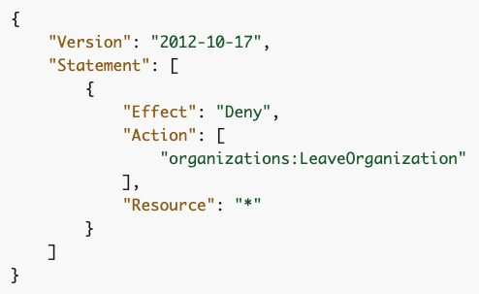
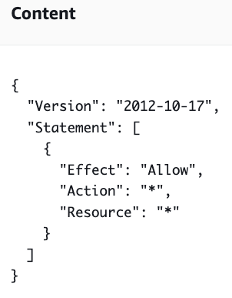
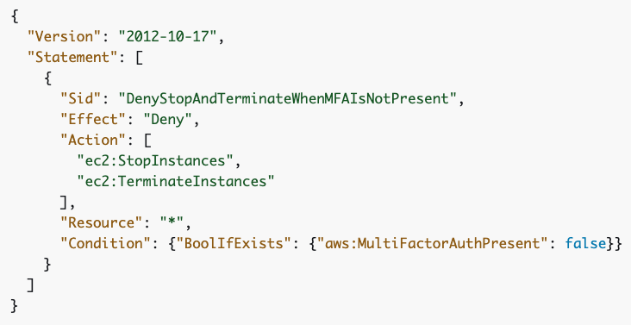
Service Control Policies
Prevent Account from leaving:
Default & Untouchable:
Require MFA:
https://t.me/CyberFreeCourses
From:https://cloud.hacktricks.xyz/pentesting-cloud/aws-pentesting/aws-basic-information#service-control-policy-scp

Slide 9
ARN - Amazon Resource Name
Unique name every resource inside AWS has, its composed like this:
arn:partition :service :region :account-id :resource-type/resource-id
arn:aws :elasticbeanstalk :us-west-1 :123456789098 :environment/App/Env
Note that there are 4 partitions in AWS but only 3 ways to call them:
AWS Standard: aws
AWS China: aws-cn
AWS US public Internet (GovCloud): aws-us-gov
AWS Secret (US Classified): aws
https://t.me/CyberFreeCourses
From https://cloud.hacktricks.xyz/pentesting-cloud/aws-pentesting/aws-basic-information#arn

